Slide 1

Blog Website
Name : Abhishek Jain
Roll No : 205121007

Slide 2

Technology Used
HTML
CSS
JavaScript
Node-Js
Express-JS
Mongo DB for DataBase

Slide 3

Home Page
Home Page Shows Default home content after that it shows all blogs that is present in database using an array in EJS file with their title.

Slide 4
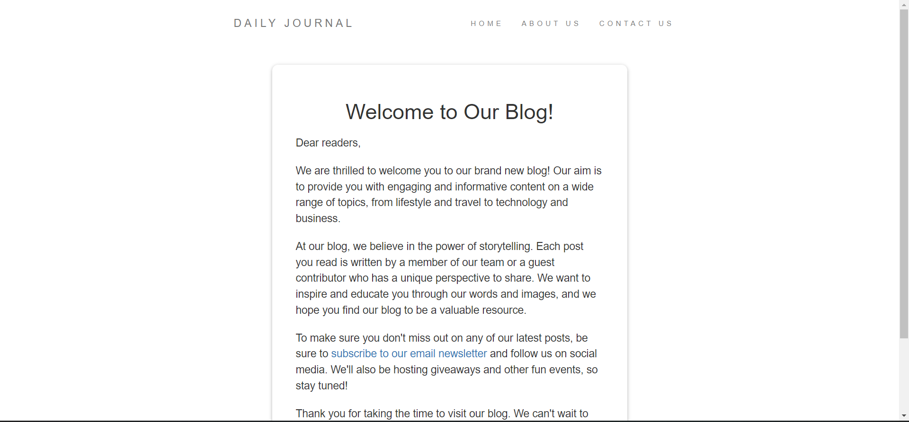
Home Page

Slide 5
Compose Page
On compose page I have given two input box on compose page one is for title and one is for content and a button to upload that and save it to database.

Slide 6


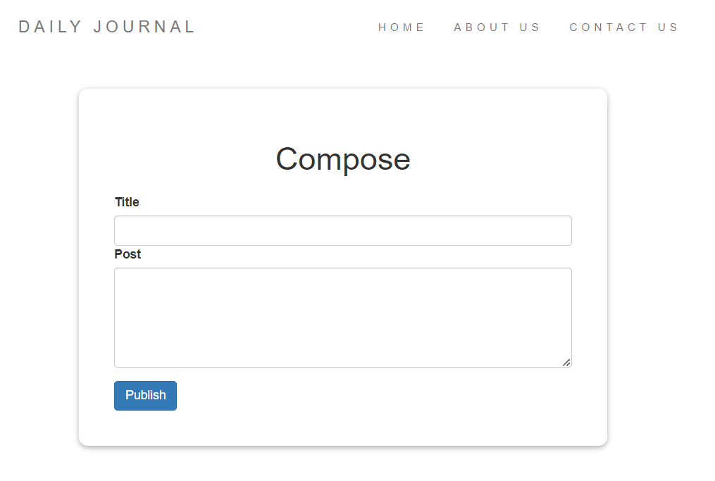


Compose Page

Slide 7
Blog Website
After Submitting the Post it redirects to the home page and will show all posts

Slide 8


Posts

Slide 9
Contact Us
In Contact Us Page there is a form which accepts user’s name, email id, Subject and message and this will also save in our database

Slide 10



THANK YOU!

